Slide 1
Reconnaissance
Chapter 5
TestOut CyberDefense Pro

Slide 2
Reconnaissance Overview
5.1
Reconnaissance
TestOut CyberDefense Pro

Slide 3
Section Skill Overview
Learn definition of reconnaissance
Understand the difference between active and passive reconnaissance
Understand the concept of enumeration
TestOut CyberDefense Pro

Slide 4
Key Terms
Enumeration
Passive reconnaissance
Active reconnaissance
TestOut CyberDefense Pro

Slide 5
Key Definitions
Enumeration: Enumerate means to list items one by one. During the enumeration phase of reconnaissance, you will extract and record as much information as you can about a network or system. Enumeration is one of the most efficient ways to scout a network and determine the best plan of attack.
Passive reconnaissance: Information-gathering techniques that do not draw attention to and cannot be traced back to the hacker.
Active reconnaissance: Information-gathering techniques that draw attention to or can be traced back to the attacker.
TestOut CyberDefense Pro

Slide 6
Reconnaissance Overview

Slide 7
Reconnaissance
Information gathering
Systematic in nature
TestOut CyberDefense Pro

Slide 8
Enumeration
List items individually
Extract system information
Helps plan attack
TestOut CyberDefense Pro

Slide 9

Reconnaissance Processes
TestOut CyberDefense Pro

Slide 10

Reconnaissance Processes
TestOut CyberDefense Pro

Slide 11
Summary
Active
Passive
Enumeration
TestOut CyberDefense Pro

Slide 12
In-Class Practice
Do the following labs:
5.1.7 Perform Reconnaissance with Nmap
TestOut CyberDefense Pro

Slide 13
Class Discussion
What is reconnaissance?
Which tools do hackers use to gather information?
What is the difference between passive and active reconnaissance?
What type of information can be gathered during the reconnaissance phase?
How can social networking, Google hacking, and search engines be used to gather information?
TestOut CyberDefense Pro

Slide 14
Reconnaissance Countermeasures
5.2
Reconnaissance
TestOut CyberDefense Pro

Slide 15
Section Skill Overview
Disable Windows services (IIS)
Manage Linux services
Enable and disable Linux services
Hide the IIS banner broadcast
TestOut CyberDefense Pro

Slide 16
Key Terms
Windows services
Linux services
IIS banner
TestOut CyberDefense Pro

Slide 17
Key Definitions
Windows services: Windows services are applications that start when the computer is booted or when a designated event occurs and run quietly in the background until shut down or they are manually stopped.
Linux services: Linux services serve a similar purpose as Windows services. In Linux, these are also called daemons.
IIS banner: Part of the header that is broadcast by websites being run in Windows IIS. It generally contains the web server version, X-Powered-By, and X-AspNet-Version.
TestOut CyberDefense Pro

Slide 18
Reconnaissance Countermeasures

Slide 19
Information Sharing Policies
Press releases
Annual reports
Websites
Product catalogs
Company social media
Employee social media
TestOut CyberDefense Pro

Slide 20

Reconnaissance Countermeasures
TestOut CyberDefense Pro

Slide 21
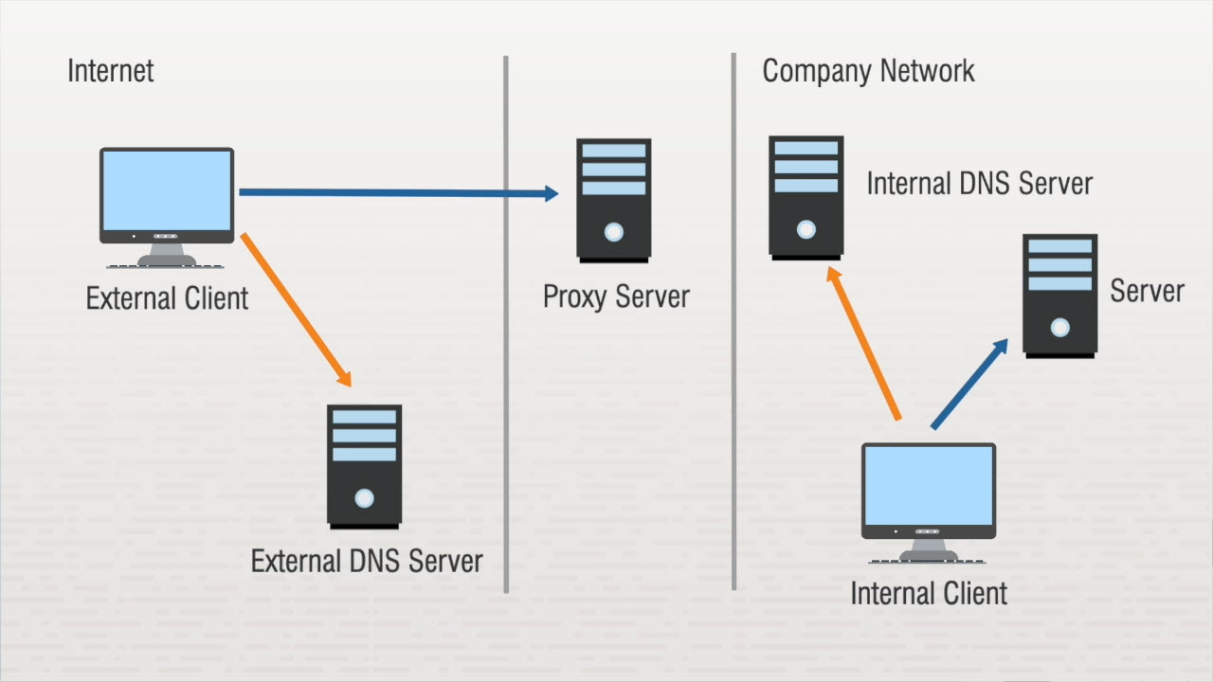
Reconnaissance Countermeasures
TestOut CyberDefense Pro

Slide 22
Summary
Information sharing policies
DNS hardening
TestOut CyberDefense Pro

Slide 23
In-Class Practice
Do the following labs:
5.2.3 Disable Windows Services
5.2.5 Manage Linux Services
5.2.6 Enable and Disable Linux Services
5.2.9 Hide the IIS Banner Broadcast
TestOut CyberDefense Pro

Slide 24
Class Discussion
How can companies limit the types of information hackers can gather about them?
What can you do to keep DNS servers up to date?
What types of information should you include in your information sharing policies?
TestOut CyberDefense Pro

Slide 25
Scanning
5.3
Reconnaissance
TestOut CyberDefense Pro

Slide 26
Section Skill Overview
Perform a scan
Perform a decoy scan
Perform a process scan
TestOut CyberDefense Pro

Slide 27
Key Terms
Scanning
Port scan
Network scan
Vulnerability scan
TestOut CyberDefense Pro

Slide 28
Key Definitions
Scanning: Scanning is the process of actively engaging with a target in an attempt to gather information about a network.
Port scan: A port scan probes a server or host for open ports.
Network scan: You can use network scans to find live computers on a network.
Vulnerability scan: You can use vulnerability scans to find system weaknesses such as open ports and access points.
TestOut CyberDefense Pro

Slide 29
Scanning Processes

Slide 30
Network Scans
Finds live computers
Completed through wardialing
  Uses modems
  Dials large block of numbers
TestOut CyberDefense Pro

Slide 31

Scanning Processes
TestOut CyberDefense Pro

Slide 32
Network Scans
Modems still used for:
  Fax machines
  Copiers
  Backup internet access
Phone numbers used for:
  Video meetings
  Audio meetings
TestOut CyberDefense Pro

Slide 33
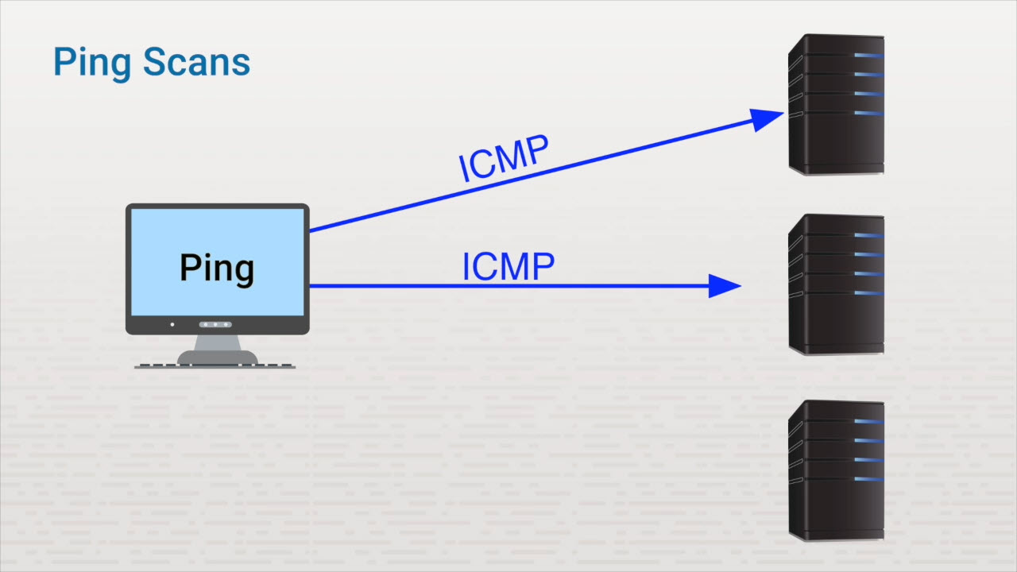
Scanning Processes
TestOut CyberDefense Pro

Slide 34
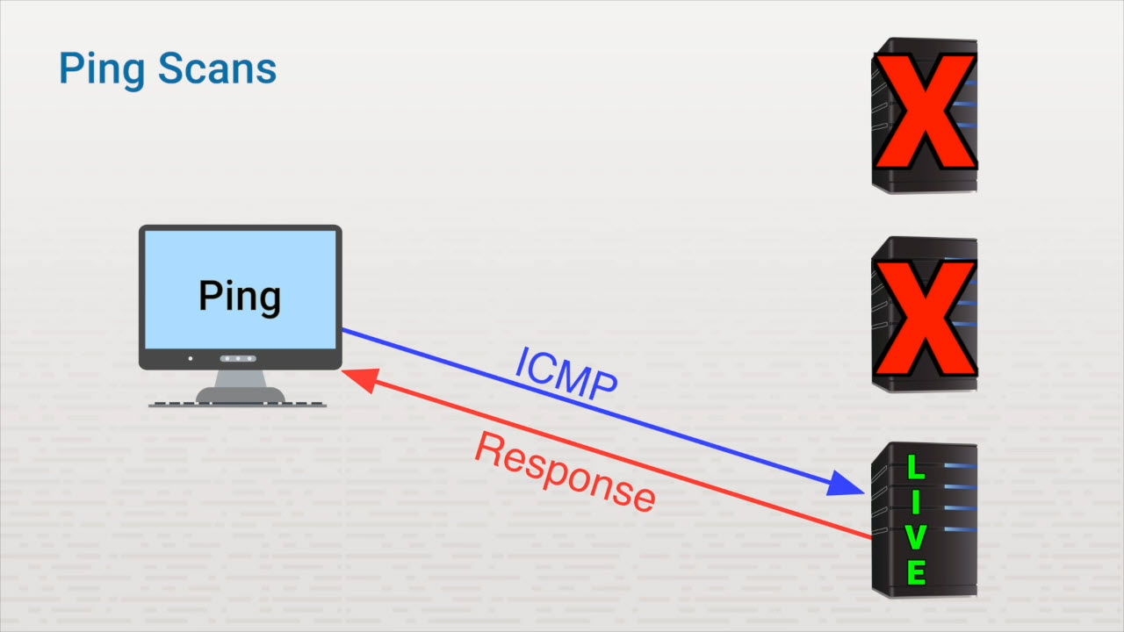
Scanning Processes
TestOut CyberDefense Pro

Slide 35
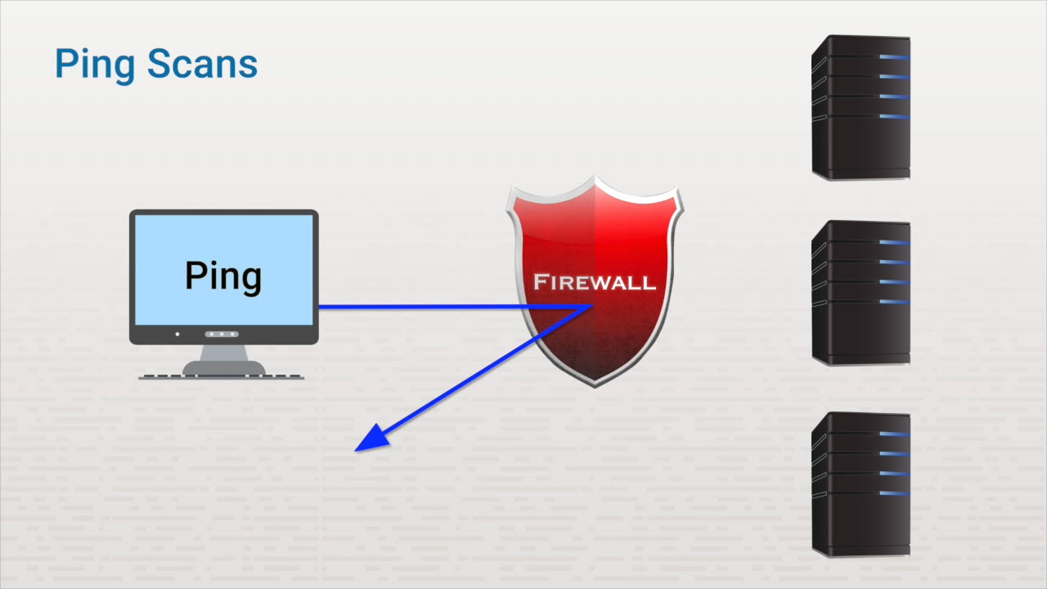
Scanning Processes
TestOut CyberDefense Pro

Slide 36
Port Scans
Nmap scans ports
TCP
>>>Connection-oriented
>>>Three-way handshake
TestOut CyberDefense Pro

Slide 37
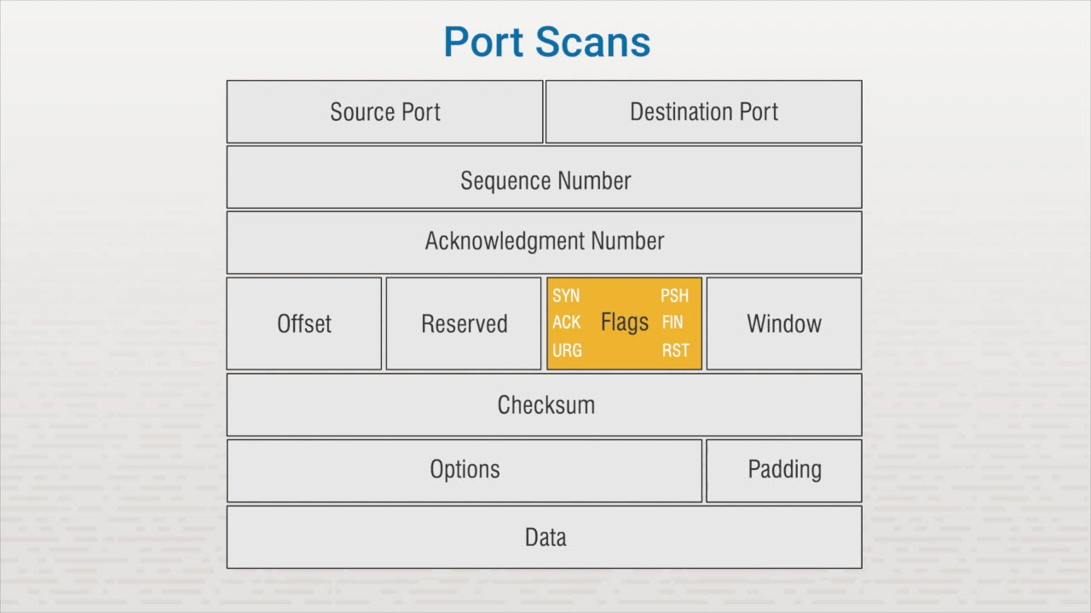
Scanning Processes
TestOut CyberDefense Pro

Slide 38
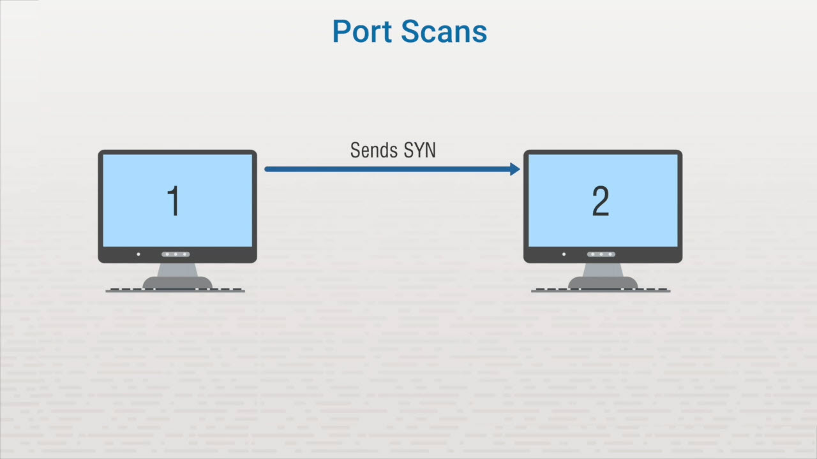
Scanning Processes
TestOut CyberDefense Pro

Slide 39
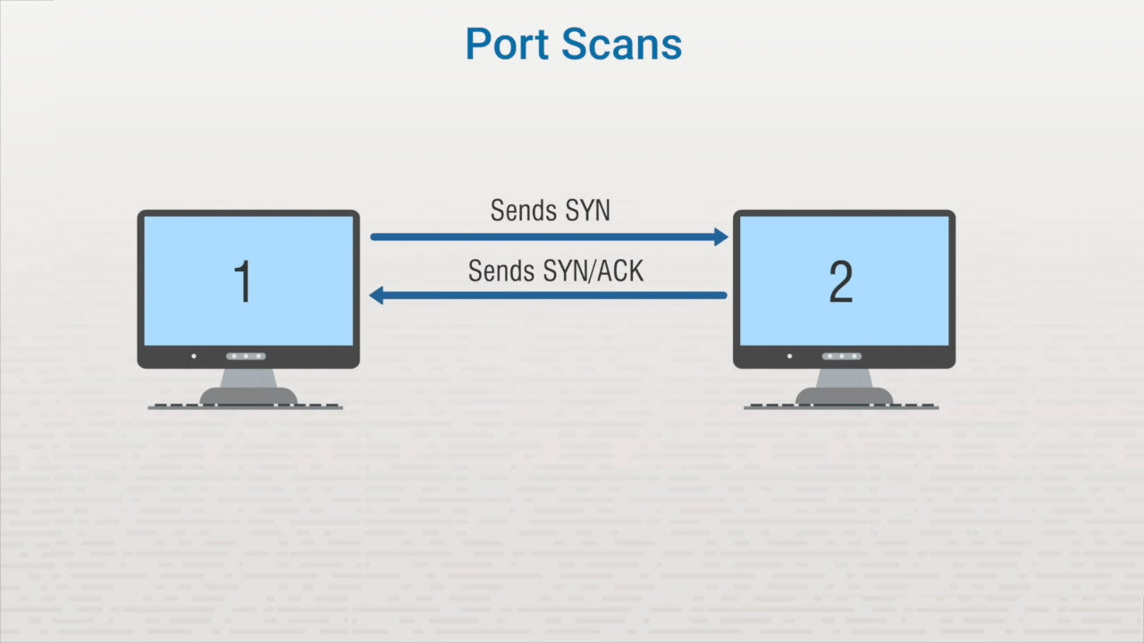
Scanning Processes
TestOut CyberDefense Pro

Slide 40
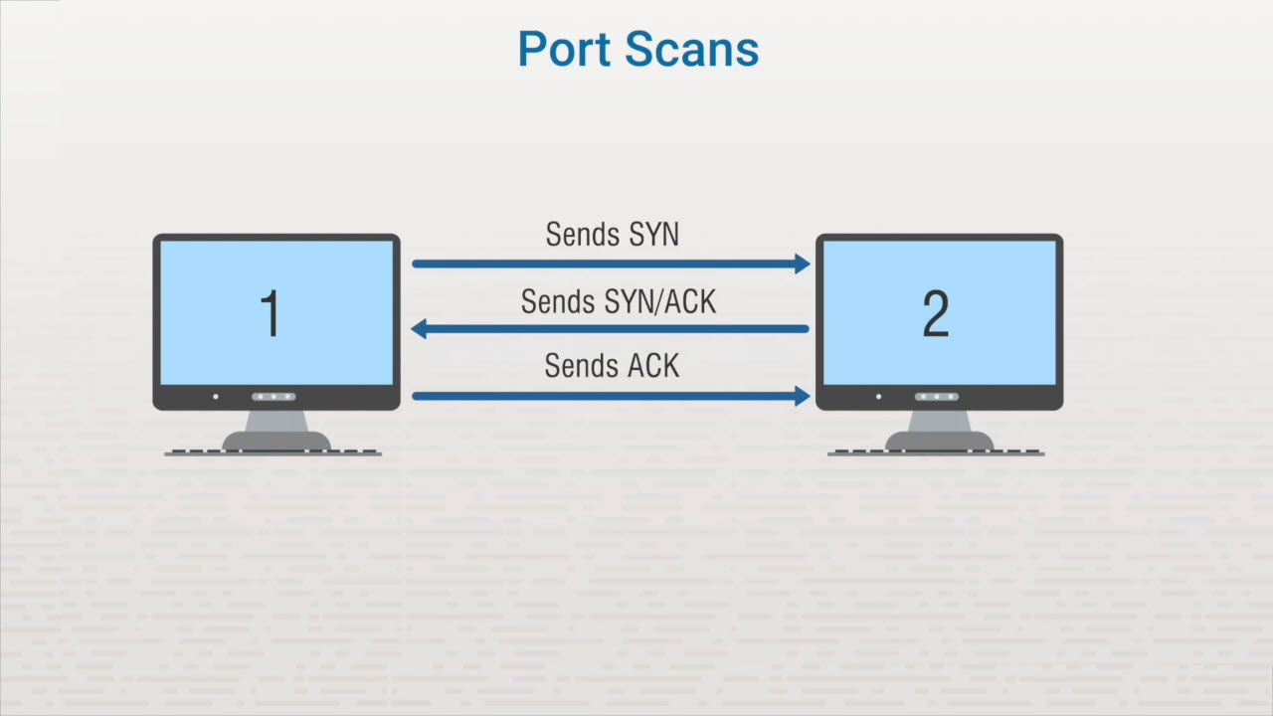
Scanning Processes
TestOut CyberDefense Pro

Slide 41

Scanning Processes
TestOut CyberDefense Pro

Slide 42
Stealth Scan
Sends a SYN packet
No final ACK received
Detected by most IDSs
TestOut CyberDefense Pro

Slide 43

Scanning Processes
TestOut CyberDefense Pro

Slide 44
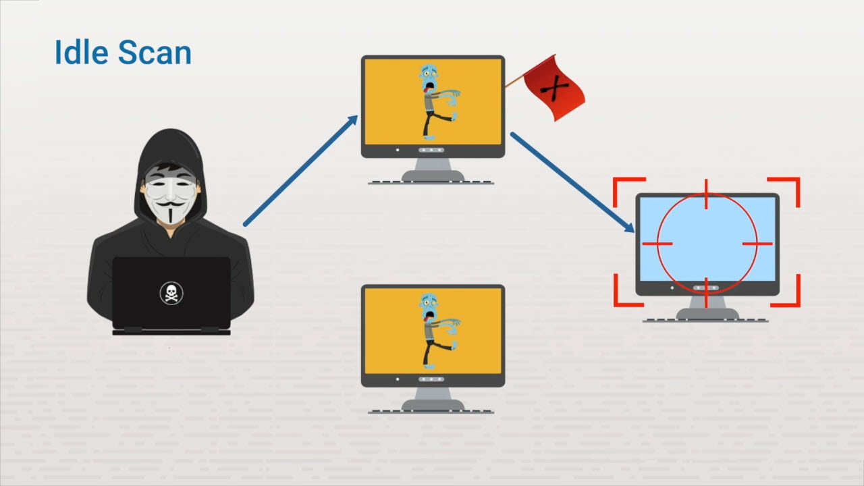
Scanning Processes
TestOut CyberDefense Pro

Slide 45
OS Scans
Looks for OS types
Analyzes TTL
TestOut CyberDefense Pro

Slide 46
Banner Grabbing
Provides system info
Captured with Telnet
Banners can include:
  Software type
  Version
  Services
  Patches
  Last modification date
TestOut CyberDefense Pro

Slide 47
Summary
Live hosts
Open ports
Operating systems
Services
Patches
TestOut CyberDefense Pro

Slide 48
Scanning Considerations

Slide 49
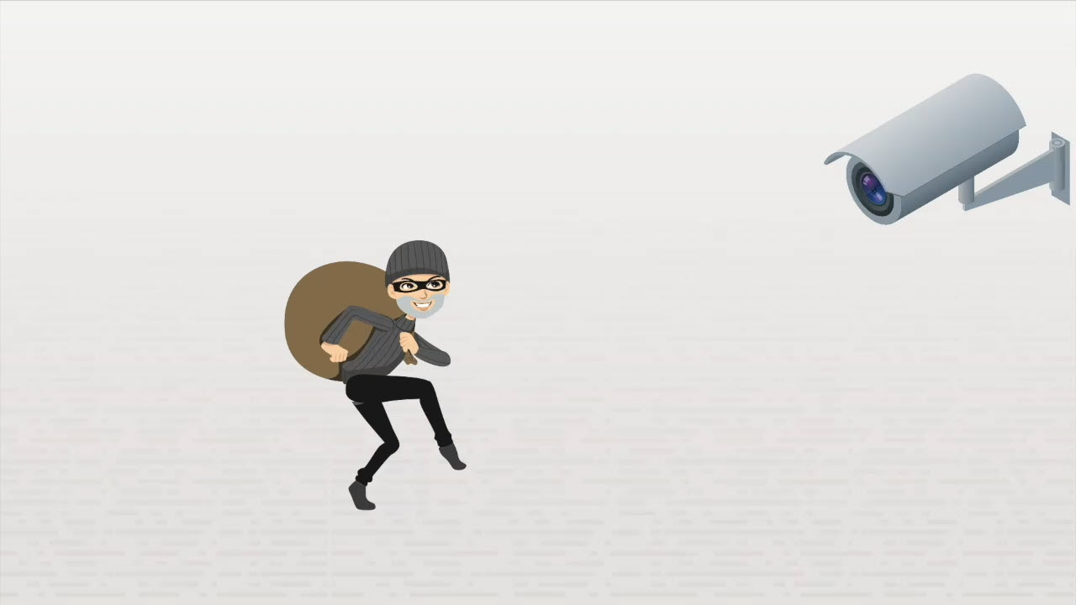
Scanning Considerations
TestOut CyberDefense Pro

Slide 50
Scanning Considerations
Various tools
Time of day
TestOut CyberDefense Pro

Slide 51
Evasion
ACK scanning
Fragmenting
Spoofing an IP address
Proxy
TestOut CyberDefense Pro

Slide 52

Scanning Considerations
TestOut CyberDefense Pro

Slide 53

Scanning Considerations
TestOut CyberDefense Pro

Slide 54
Vulnerability Scan
Ports
Banners
Coding
High-target areas
TestOut CyberDefense Pro

Slide 55
Prevent Banner Grabbing
Disable banners
Hide file extensions
Custom error pages
TestOut CyberDefense Pro

Slide 56
Summary
Hacker tools
Spoofing IP addresses
Fragmenting packets
Countermeasures
TestOut CyberDefense Pro

Slide 57
In-Class Practice
Do the following labs:
5.3.4 Troubleshoot Connectivity with ping/hping3
5.3.6 Perform an Internal Scan with Nmap
5.3.7 Perform an External Scan Using Zenmap
5.3.12 Scan for Zombie Processes
TestOut CyberDefense Pro

Slide 58
Class Discussion
What is scanning?
Which types of scanning are used to gather information about a target?
Which tools can be used for scanning?
What type of information can be gathered with scanning?
How can organizations protect themselves against scanning attempts?
TestOut CyberDefense Pro

