Slide 1
ITCS 3166
Channel Allocation Problem/Multiple Access Protocols Group 3

Slide 2
What is channel allocation?
Channel allocation deals with the allocation of channels to cells in a cellular network. Once the channels are allocated, cells may then allow users within the cell to communicate via the available channels. In other words, certain protocols are needed to allow each user to communicate without interference. Even though there are variety of practices, channel allocation can be better achieved either by static or dynamic approach.

Slide 3
Static channel Allocation:
Two common static channel allocation techniques are TDMA and FDMA.
Time Division Multiple Access (TDMA)
Frequency Division Multiple Access (FDMA)
The performance of static channel allocation depends on:
The variation in the number of users over time.
The nature of the traffic sent by the user.

Slide 4
If there are n users, the bandwidth is divided into N equal sized portions.
If fewer than n users are currently interested, a large piece of bandwidth is wasted.
If more than n users want to communicate, some of them access will be denied due to the lack of bandwidth.
In some cases, even if users are assigned to a particular frequency bandwidth, they hardly ever transmit or receive anything.
Even though, the static approach is continues to be used in telephone networks, as well as cellular, terrestrial wireless, and satellite networks at a higher level of granularity, it is a poor fit to most of the computers where data traffic is extremely bursty.

Slide 5
The poor performance of static channel allocation can be calculated by the formula
T = 1/(µC-λ).
Where T is mean time delay
Channel of capacity = C
Average arrival rate = 1/µ
Frame arrival rate is =λ

Slide 6
Question:
What are the two common static channel allocation techniques?
TDMA, & FDMA

Slide 7
Dynamic Channel Allocation
With a dynamic approach the allocation of the channel changes based on the traffic generated by the users. In DCA systems, no set relationship exists between channels and cells. Instead, channels are part of a pool of resources. Whenever a channel is needed by a cell, the channel is allocated under the constraint that frequency reuse requirements cannot be violated.

Slide 8
5 Assumptions for Dynamic Channel Allocation
Continuous or Slotted time –
Continuous time transmission can begin at any time
Slotted time means that transmission must start at the beginning of the interval
Independent Traffic – n amount of stations generates frames for transmission, once the frame is generated the station is blocked until frame transmission
Carrier Sense or No Carrier Sense – carrier sense checks to see if channel is in use before transmission, whereas if there was no carrier sense it transmits first and then it checks to see if the transmission was successful.·

Slide 9
5 Assumptions for Dynamic Channel Allocation cont.
Single Channel – One channel is used for communication
Observed Collision – when two frames are overlapped it may cause it to “collide”
Collisions needs to be transmitted again.

Slide 10
ALOHA
ALOHA is wireless data system that was developed at the University of Hawaii by Norman Abramson.
ALOHA was developed due to the need to run communications between all of the small islands making up hawaii.
The impracticality of using cables between the islands necessitated the development of a wireless system.
ALOHA uses the same upstream frequency for each user and uploads the frames to a central terminal.
ALOHA deals with sending frames 2 different ways, pure and slotted.

Slide 11
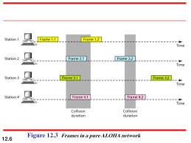
Pure ALOHA
Pure ALOHA sends out the users frames without regard for collision avoidance.
The senders only listen for if the frame is destroyed before reaching the central terminal.
If the frame was destroyed then the senders wait a random interval before sending another.
This process repeats until the sender gets confirmation that the frame has successfully made it to the central terminal.
This process embodies the idea of quantity over quality, the more times a frame is sent out the greater chance of it not colliding with any other frame.
Due to the random nature of the collisions this process is not very efficient and only has an 18% channel utilization.

Slide 12
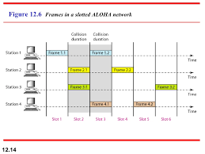
Slotted ALOHA
Slotted ALOHA was developed as a way to make pure ALOHA more efficient.
Instead of each sender transmitting frames at random intervals slotted ALOHA segments time into specific intervals called slots for frames to travel in.
This method requires a station to indicate when the boundaries between the slots occur, usually determined beforehand by the users.
This method is almost double the efficiency of pure aloha as randomness is eliminated as a factor of collision frequency.
Even though this process was developed in the 70’s it proved useful when Internet over cable was developed as it solved the problem of allocating a shared channel to multiple users.

Slide 13
Question
True or false: Slotted ALOHA prevents collision entirely.
False: Slotted ALOHA only allocates segments it does not control if multiple users attempt to send on the same segment.

Slide 14
Carrier Sense MAP
Carrier Sense Multiple Access Protocols are protocols in which stations listen for a carrier (i.e. a transmission) and act accordingly
There are three basic Carrier Sense Multiple Access Protocols:
1-persistent CSMA - When a station needs to send data, it listens to the channel. If the channel is idle, the station transmits but if the channel is busy, it just waits until it becomes idle. If a collision occurs, the station waits a random amount of time and repeats. This is called 1-persistent because the station transmits with a probability of 1 when the channel is idle.
nonpersistent CSMA - The station listens to, or senses, the channel and if it's idle, it transmits but if the channel is busy, it waits a random amount of time before repeating the algorithm instead of continuously waiting for the channel to be idle.
p-persistent CSMA - Applies to slotted channels. If the channel is idle, the station transmits with a probability p. Then, it defers until the next slot with a probability of q = 1 - p.

Slide 15
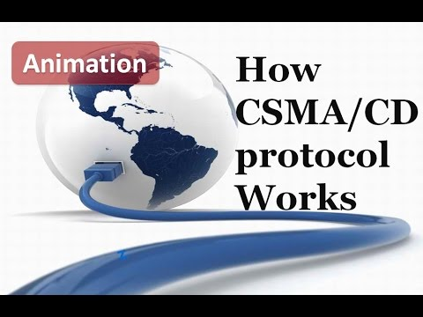

Slide 16
CSMA with Collision Detection
This protocol is the basis of the classic ethernet LAN.
Similar to previous protocols except CSMA/CD has collision detection built in
A collision is when two stations sense that a channel is idle and start transmitting simultaneously
If a collision occurs in this protocol, the station aborts its transmission, waits a random period of time, and tries again if the channel is idle.
CSMA/CD can be in contention, idle, or transmission state

Slide 17
Question
Name one of the three basic CSMA protocols
1-Persistent, Non-Persistent, P-Persistent

Slide 18
Collision Free Protocols
Bit-map Protocol
There is a contention period in which each station announces they have data to send by sending a 1 bit.
After this they send their frames
Token Passing
Stations passes a token from one station to another
The token is for permission to send, if it doesn’t need to send it passes the token

Slide 19
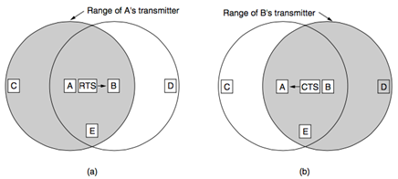
Multiple Access with collision avoidance
MACA is primarily done with wireless because of the limitations wireless has that wired does not
A sender request to send and the receiver clears the station for the incoming transmission.

Slide 20
Question
What is the difference between CSMA/CD and CSMA/CA
CSMA/CD is Collision Detection
CSMA/CA is Collision Avoidance

Slide 21
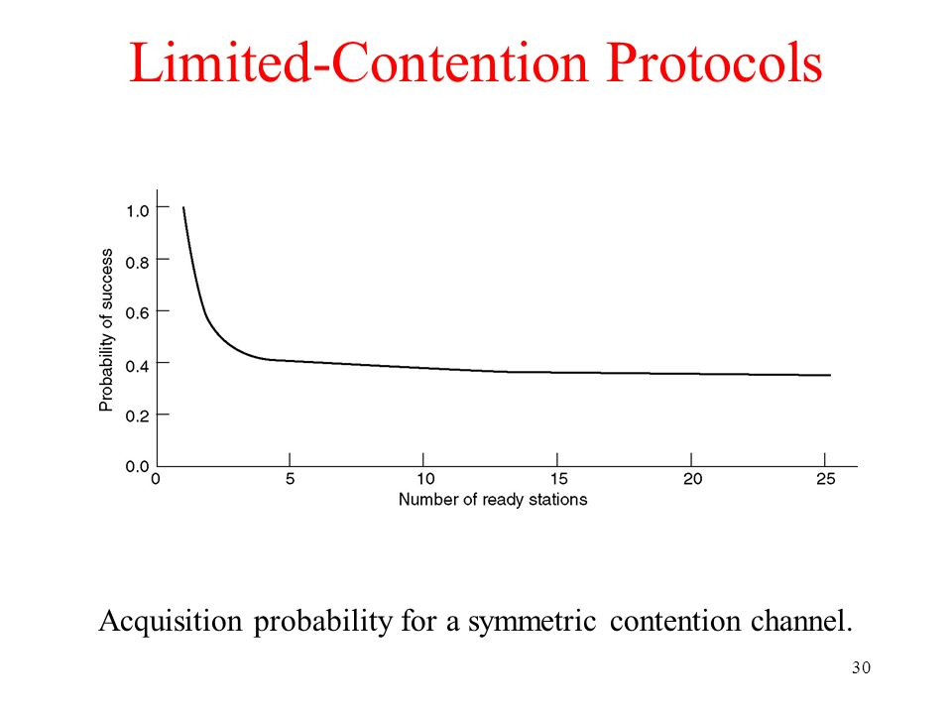
Limited-Contention Protocols
Collisions are rare
Prefered under conditions of light load because of delay
Attempt to combine the best properties of contention and collision free protocols

Slide 22
How limited-contention protocols work
Stations get divided into groups
Only members of group 0 can compete for slot 0
If successful, the member acquires the channel and transmits its frame
If not, the members of group 1 compete for slot 1

Slide 23
Question
What group members can compete for slot 0?
Members of group 0

