Slide 1

Bluetooth Background
1998- Ericsson, IBM, Intel, Nokia, and Toshiba
Goal: develop a wireless standard for connecting mobile phones to other devices using short range, low-power, inexpensive wireless radios.
1999- Bluetooth 1.0 released
Allows devices to securely transfer data through pairing
Bluetooth 2.0, 3.0, and 4.0

Slide 2
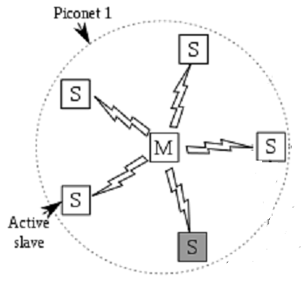
Bluetooth Architecture
Basic unit of a Bluetooth system is a piconet
1 master node- controls the clock and determines which device gets to communicate during which time slot
Up to 7 active slave nodes
Up to 255 parked nodes
Multiple piconets connected via bridge node- scatternet

Slide 3
Bluetooth Architecture (cont.)
The master/slave design was chosen because the designers intended to design the Bluetooth chips for under $5.
The slave nodes are dumb; they do whatever the master node tells them to do

Slide 4
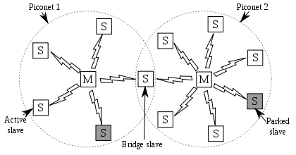
Scatternet Example

Slide 5
Bluetooth Applications
Most network protocols are generic
Bluetooth differs. It specifies particular profiles to handle different things.
25 different applications/profiles (6 for audio and video, connecting keyboard to computer, sending images from camera to printer, mobile phone used as a remote, etc.)

Slide 6
Bluetooth Applications (cont.)
It would have been possible to get away with 2 applications/profiles
One for file transfer and the one for streaming real-time communication
Different working groups- each had their own applications/profiles

Slide 7
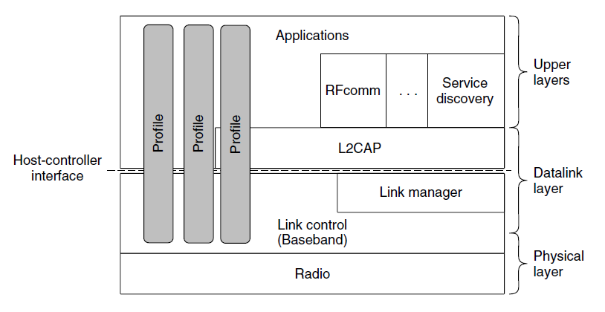
The Bluetooth Protocol Stack
Figure 4-35. The Bluetooth protocol architecture

Slide 8
The Bluetooth Radio Layer
The radio layer is the lowest defined layer of the Bluetooth specification
Moves bits from master to slave, or vice versa
Low power system

Slide 9
The Bluetooth Radio Layer
Earlier versions of Bluetooth interfered and ruined each other’s transmissions. Solution was adaptive frequency hopping
Three forms of modulation are used to send bits on a channel

Slide 10
The Bluetooth Link Layer
Turns the bit stream into frames and defines some key formats
The link manager protocol sets up logical channels to carry frames between master and slave

Slide 11
The Bluetooth Link Layer
Secure simple pairing
Synchronous Connection Oriented (SCO) link
Asynchronous ConnectionLess (ACL) link

Slide 12
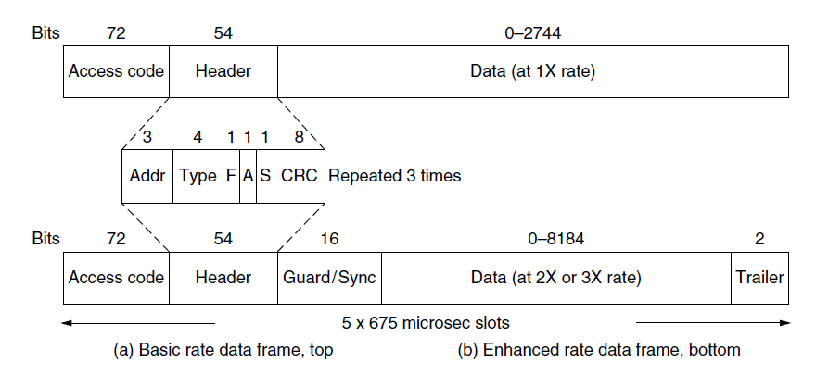
4.6.6 The Bluetooth Frame Structure
Figure 4-36. Typical Bluetooth data frame

Slide 13
RFID
Radio Frequency Identification

Slide 14
EPC--What it is
A type of RFID
Short-range (10m) network
“Electronic Product Code” (High-tech barcode)

Slide 15
How it works
Two components: “readers” and “tags”
Commands given through reader; tags obey the reader
Readers “power” the tags wirelessly
Tags either absorb signals or bounce them back to the reader

Slide 16
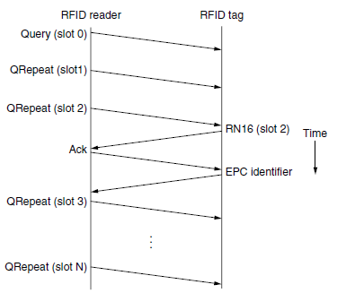
Establishing a connection
Reader first broadcasts a request for tag IDs within range
Responses slotted like ALOHA
Tags respond at a random slot
Check connection first before transmitting ID
If reader sends the OK, respond with ID
Slot number can be changed dynamically

Slide 17
Operating on Tags
Once IDs are known, the reader can act on them
IDs can read and write to tags
Tags respond only with data—no headers

Slide 18

Message Formats
Physical layers: set properties such as transfer rate
Tag Selection layers: chooses which tags to connect and allows multiple connections.
Q: Defines how many slots the tag will respond in.
CRC: Error detection

Slide 19
Data Link Layer Switching, What it Does
Data Link Layer: Transforms raw transmission facilities into lines that appear to be free of undetected transmission errors.
Masks the real errors so that the network does not see them
Use of data and acknowledgement frames

Slide 20
Learning Bridge
Learning Bridge - Bridges “Learn as they go”
Backward Learning
Routing Procedure
If destination port == Source port, discard frame.
If destination port != Source port, send frame to destination port.
If destination port not known, use flooding to send frame to all except source.
Notes:
Operate in the Data link Layer

Slide 21
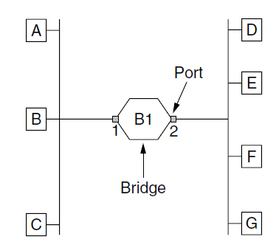
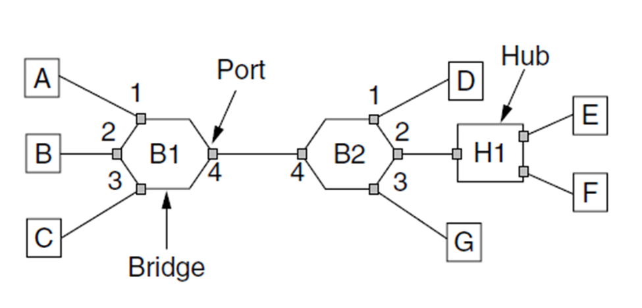
Learning Bridge Diagram
Learning Bridge Connecting multiple LANs : Fig 4-41 (a)
Learning Bridge Connecting 7 Point-to-Point Stations : Fig 4-41 (b)

Slide 22
Spanning Tree Bridge
Spanning Tree Bridge - Spanning Trees laid over topology.
“Loops in the Topology”
overcome by ignoring some potential connections
valid connections for a Spanning tree.
Spanning Tree built using a distributed algo

Slide 23
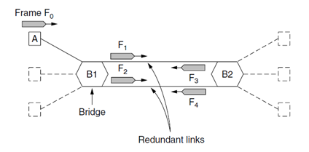
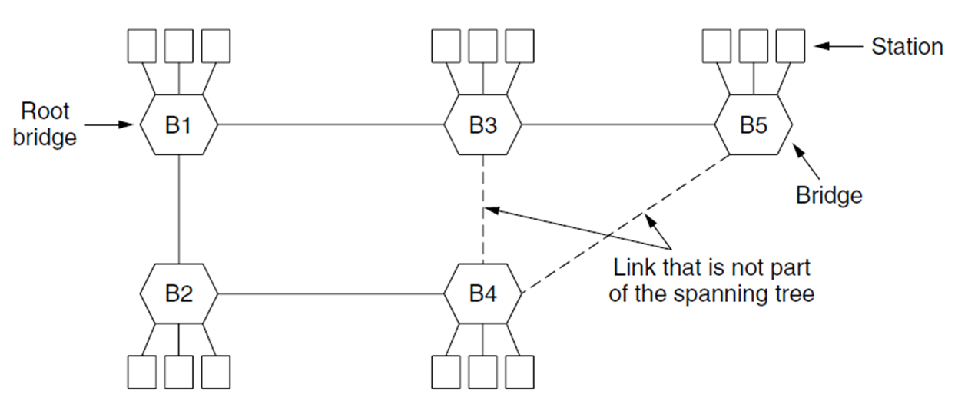
Spanning Tree Bridge Diagram
Spanning Tree Bridge with parallel Links : Fig 4-43
Spanning Tree Bridge connecting 5 bridges: Fig 4-44

Slide 24
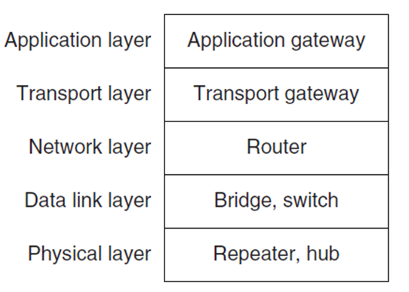
Repeaters, Hubs, Bridges, Switches, Routers, and Gateways
Switches - Modern bridges by another name
Bridges connect a few LANs
Modern installations tend to have point-to-point links meaning switched tend to have many ports
Which devices go in which layer : Figure 4-45 (a)

Slide 25
VLANs
Super dry stuff

Slide 26
Typical LANs
LANs are broken up departmental lines
All computers in a LAN connect to the same switches
Cannot easily span across long distances (buildings, cities, planets, etc.)
Physical labor overhead
Not very hip

Slide 27
Solution: make LANs logical
LANs no longer based on direct connection
Any computer can be connected to any LAN on the network
Smoother transitions for employees
Much easier to expand/modify LANs

Slide 28
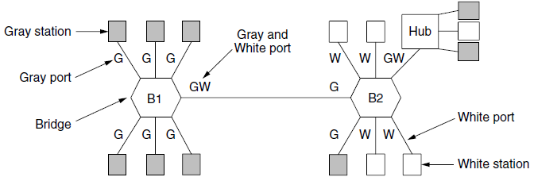
How it works
All VLANs have a “color”
Bridge/Switch ports know which colors are on the other end

Slide 29
IEEE’s brilliance
Backwards compatibility
Frame headers needed to include VLAN information
Only bridges and switches need use VLAN headers
Switches assign VLAN colors to each of their ports

Slide 30
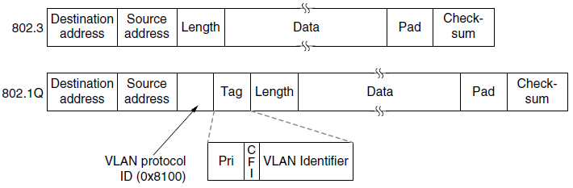
Modified headers
Slight addition to Ethernet headers

