Slide 1
Congestion Control, Quality of Service, & Internetworking

Slide 2
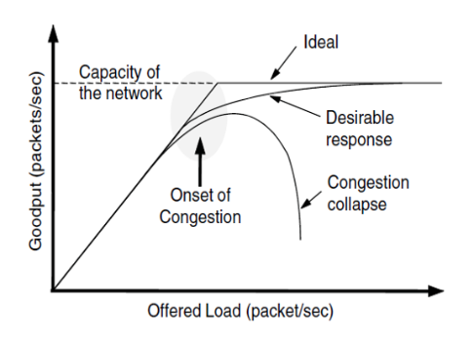
Congestion
Congestion - too many packets present in the network causes delay and loss that affects performance negatively.
As the offered load increases beyond the capacity of the network, the network will experience Congestion Collapse.
Goodput is the rate at which useful packets are delivered by the network.

Slide 3
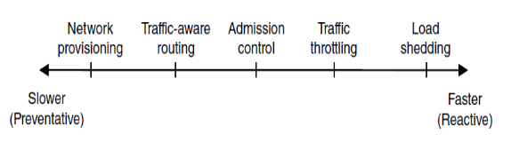
Congestion Control Approaches
Approaches to congestion control range from slower (preventative) techniques to faster (reactive) techniques.
Network Provisioning
Traffic-aware routing
Admission Control
Traffic Throttling
Load Shedding

Slide 4
Congestion occurs because there are too many packets present in the network, slowing down performance
True
False

Slide 5
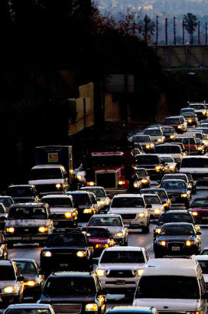
Network Provisioning, Traffic Aware Routing, Admission Control
Network Provisioning - upgrading and equipping links and routers to handle congestion in line with long-term traffic trends.
Traffic-aware routing - attempting to predict which routes will become congested and shifting traffic away from these routes. Considers the load to calculate the next shortest path/distance for route weight.
Admission Control - prevent the creation of virtual circuits unless the network can handle the added traffic. Leaky or token buckets are 2 algorithm methods that bound the average rate and burst size of traffic.

Slide 6


Traffic Throttling & Load Shedding
Traffic Throttling - networks warn users to slow down sending transmissions if congestion is about to occur. Catches congestion before it happens and sends a choke packet , requiring the host to reduce its amount of traffic.
Load Shedding - discarding packets based on 2 algorithms, Milk and Wine. Discarding packets is usually last resort. Another method is called Random Early Detection.
Milk - send new packets but drop old ones.
Wine - send old packets but drop new ones.
RED - algorithm that decides to start dropping packets. Chooses small amount at random to drop
VS

Slide 7
What are 2 algorithms used in load shedding commonly called?

Slide 8
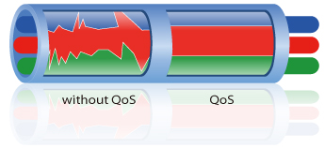
Quality of Service (QoS)
Quality of Service - a network’s ability to achieve maximum speed and bandwidth while dealing with network performance issues such as latency, error rate, and uptime.
Congestion control techniques previously discussed are not enough for applications and users that demand stronger performance and multimedia usage.
Overprovisioning - allocating more computer data storage and handling capacity than is strictly necessary. Solving QoS issues by “throwing money at it.”

Slide 9
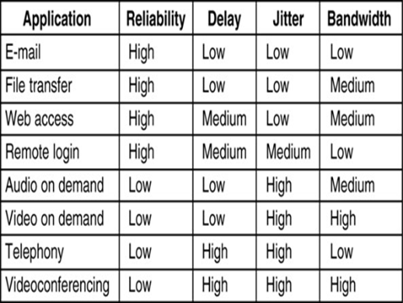
Application Requirements
A stream of packets from a source to a destination is called a flow
4 parameters dictate the needs of each flow
  Bandwidth
  Jitter (variation in arrival times)
  Delay
  Loss

Slide 10
What solution for Quality of Service is equivalent to “throwing money at the problem”
Overestimating
Overprovisioning
Overcomplicating
Overreacting

Slide 11
Traffic Shaping & Paket Scheduling
Traffic Shaping
Leaky Bucket Algorithm - packet flow is constant rate from the bucket
Token Bucket Algorithm - bucket has a fixed capacity but it must wait for tokens to arrive before sending packets
Packet Scheduling
FIFO -Packets are sent out in the order that they are received (First in First Out)
FCFS - Routes packets on a (First come first serve) basis, queueing packets while older ones are sent.

Slide 12
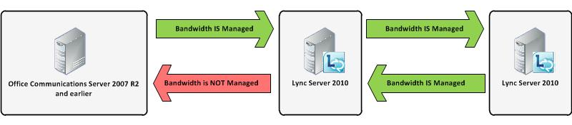
Admission Control
Do not set up a new virtual circuit unless the network can carry the added traffic without becoming congested.
The trick with this approach is working out when a new virtual circuit will lead to congestion

Slide 13
What are the 2 main types of packet scheduling?

Slide 14
Integrated & Differentiated Services
Between 1995 and 1997, IETF put a lot of effort into devising an architecture for streaming multimedia. This work resulted in over two dozen RFCs, starting with RFCs 2205–2212.
while work continues to advance integrated services, few deployments of it or anything like it exist yet.
one that can be largely implemented locally in each router without advance setup and without having the whole path involved. This approach is known as class-based (as opposed to flow-based) quality of service. IETF has standardized an architecture for it, called differentiated services

Slide 15
Routing & Packet Fragmentation
Each network or link imposes some maximum size on its packets. These limits have various causes, among them
1. Hardware (e.g., the size of an Ethernet frame).
2. Operating system (e.g., all buffers are 512 bytes).
3. Protocols (e.g., the number of bits in the packet length field).
4. Compliance with some (inter)national standard.
5. Desire to reduce error-induced retransmissions to some level.
6. Desire to prevent one packet from occupying the channel too long

Slide 16
What is 1 cause of size limits in packets?

Slide 17
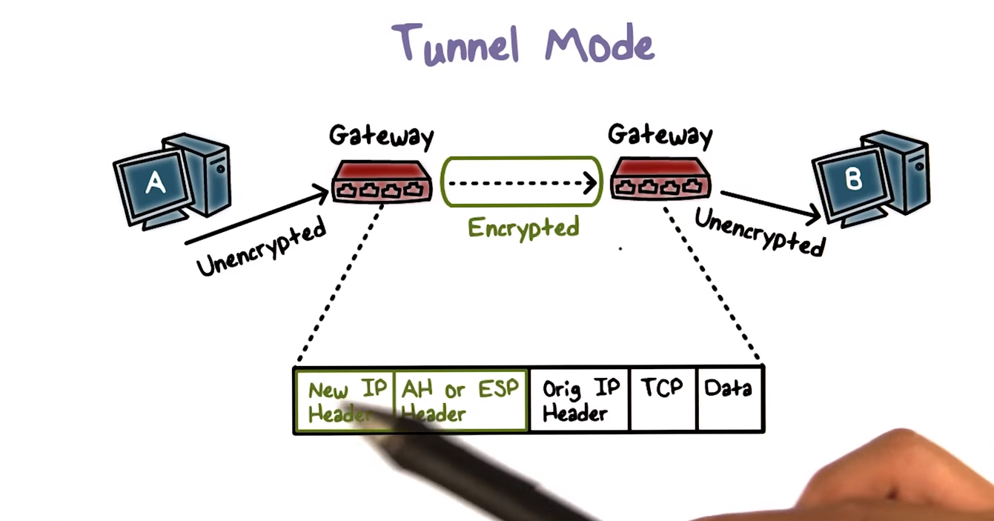
Tunneling
https://www.youtube.com/watch?v=UhiJDTU6sGQ

