Slide 1
The World Wide Web

Slide 2
Architectural Overview
From the users’ point of view, the Web consists of a vast, worldwide collection of content in the form of Web pages.
Each page may contain links to other pages anywhere in the world.
Hypertext is the ideal of one page point to another.
Pages are viewed with a program called a browser.
  Most popular: Firefox, and Internet Explorer.

Slide 3
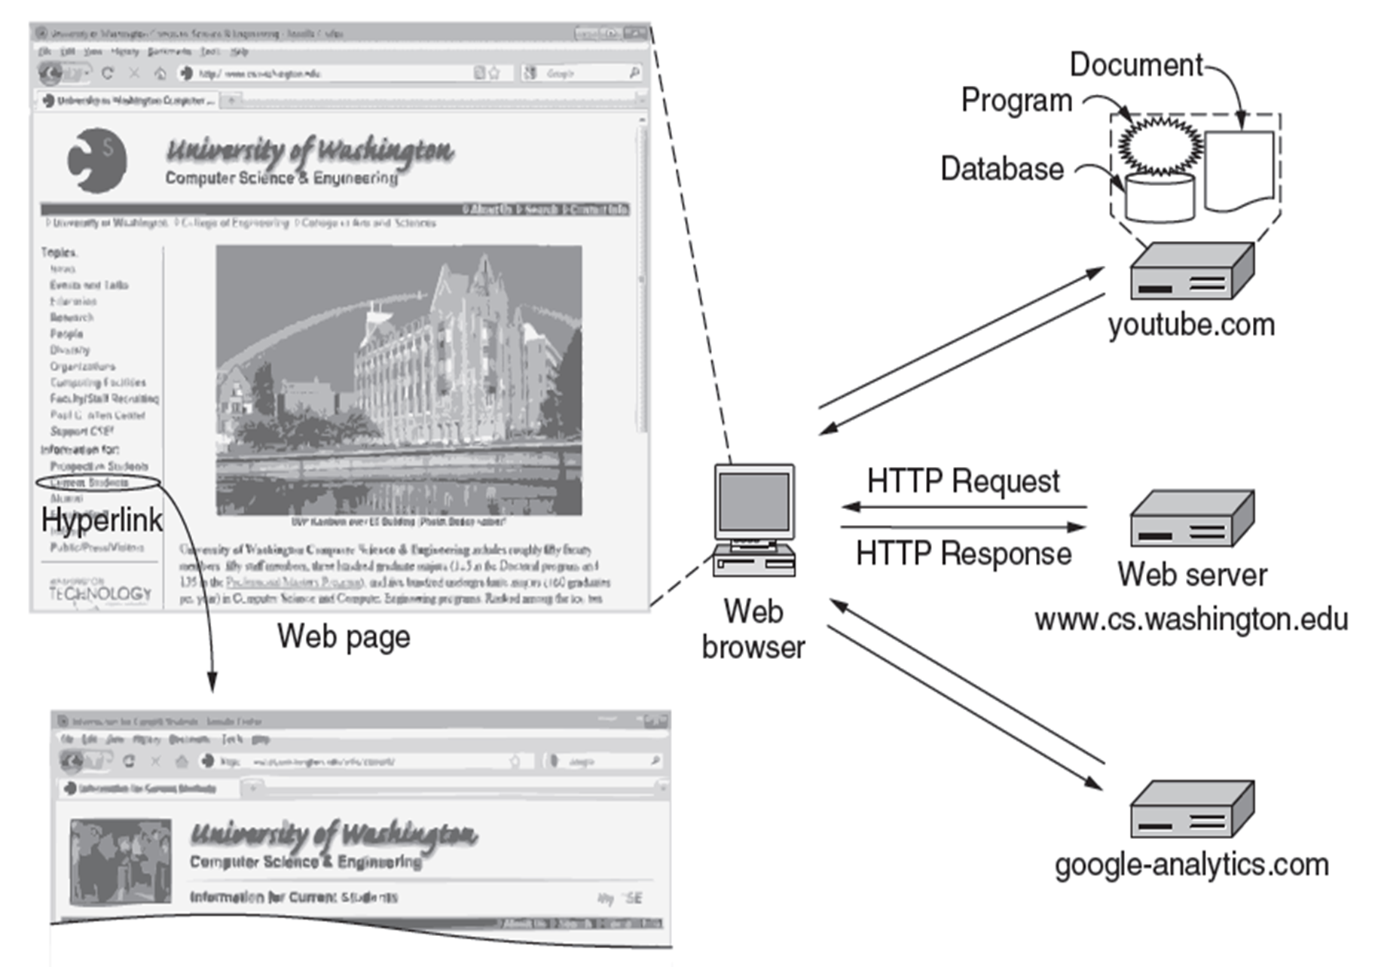
Architecture of the Web

Slide 4
Steps that occur when link is selected:
Browser determines the URL (by seeing what was selected).
Browser asks DNS for the IP address of the server (website).
DNS replies (128.208.3.88).
The browser makes a TCP connection.
Sends HTTP request for the page .
Server sends the page as HTTP response.
Browser fetches other URLs as needed.
The browser displays the page
The TCP connections are released.

Slide 5
URL
Each page is assigned a URL that effectively serves as the page’s worldwide name.
Uniform Resource Locator design is open-ended with browsers using multiple protocols to get different kinds of resources.
URLs for various other protocols have been defined.

Slide 6
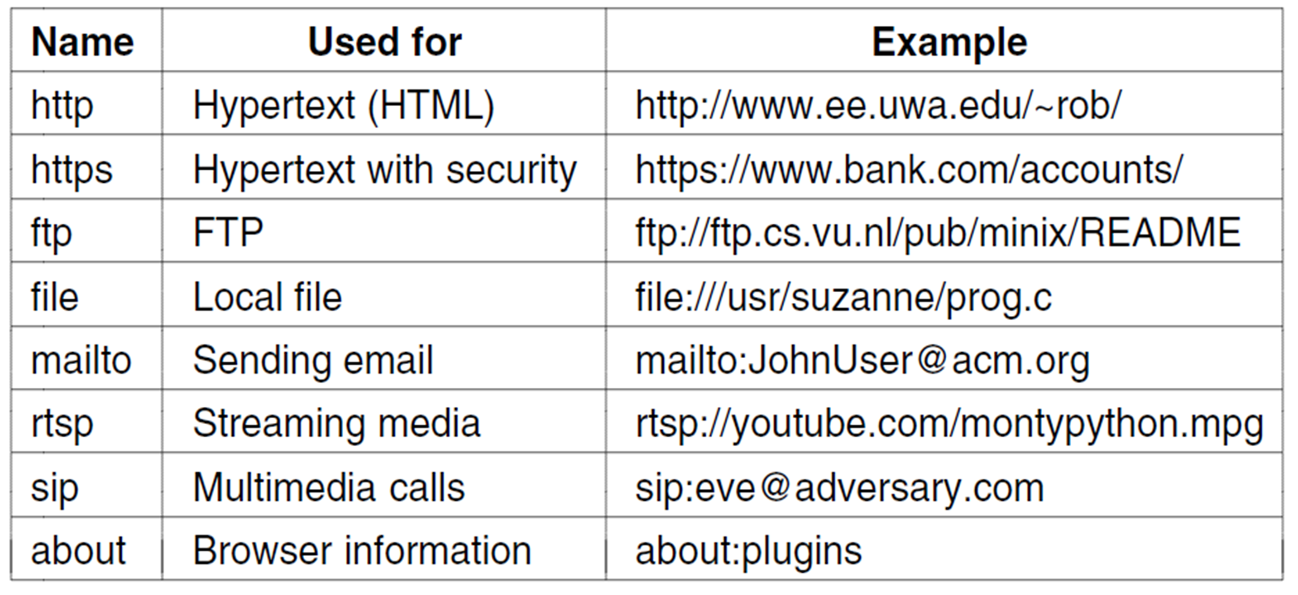
Some common URL schemes

Slide 7
The Server Side
Steps server performs in main loop:
Accept a TCP (Transmission Control Protocol) connection from client (a browser)
Get path to page, name of file requested.
Get the file (from disk).
Send contents of the file to the client.
Release the TCP connection.

Slide 8
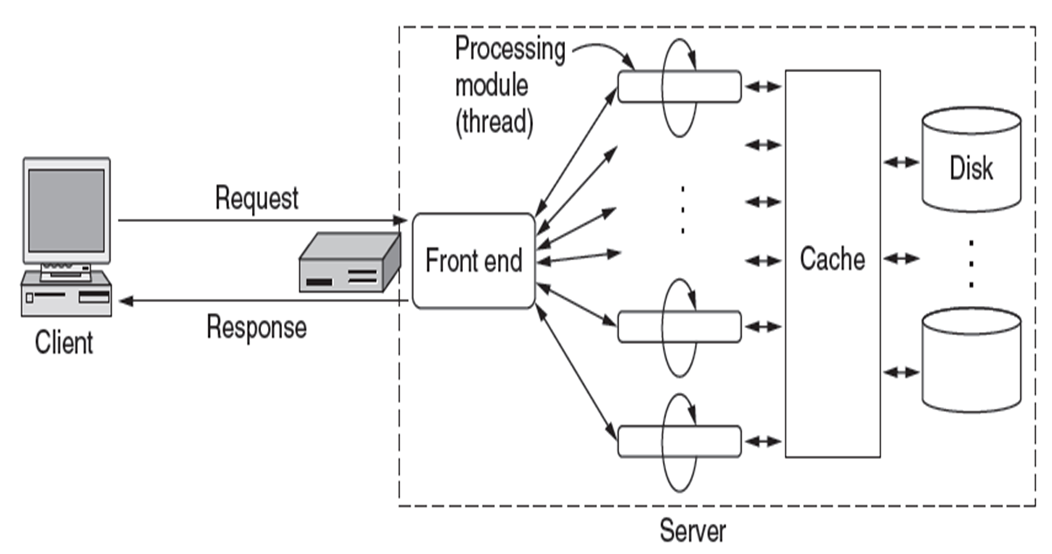
A multithreaded Web server with a front end and processing modules.

Slide 9
Modern Web Servers
More the just accept path names and return files. The actual processing of each request can get quite complicated.
A processing module performs a series of steps:
Resolve name of Web page requested.
Perform access control on the Web page.
Check the cache.
Fetch requested page from disk or run program
Determine the rest of the response
Return the response to the client.
Make an entry in the server log.

Slide 10
Static Web Page
A web page that is delivered to the user exactly as stored, in contrast to dynamic web pages which are generated by a web application.
Most are written in HTML
  HyperText Markup Language – allows users to produce Web pages that include text, graphics, video, pointers to other Web pages, and more.
  Language for describing how documents are to be formatted.
Ex.
<html> <head><title> USC UPSTATE </title></head>
<body><h1>Welcome to USC Upstate</h1></body>
<p>Wondering what college life is really like? Come see for yourself.</p>
</html>

Slide 11
Input and Forms
Sending input from the user to the server requires two kinds of support.
  Requires the HyperText Transfer Protocol to be able to carry data in that direction.
  Requires to be able to present user interface elements that gather and package up the input.
Forms contain boxes or buttons that allow users to fill in information or make choices and then send the information back to the page’s owner.
Forms are included in the HTML 2.0

Slide 12
Dynamic Web Pages and Web Applications
Dynamic web pages are web sites that are generated by a user or changed as a result of interaction with the user.

Slide 13
Client –Side Dynamic Web Page Generation
Web Pages that change in response to an action such as a mouse or a keyboard.
Content generated on the users computer rather than the server.
In these cases, the user's web browser would download the web page content from the server, process the code that's embedded in the web page, and then display the updated content to the user.
The most popular scripting language for client side is JavaScript.

Slide 14
Server-Side Dynamic Web Page Generation
Web pages that change when a web page is loaded or visited
Examples: login pages, submission forms, and shopping carts
Scripting languages such as PHP, ASP, ASP.NET, ColdFusion, and Perl allow web pages to respond to submission events

Slide 15
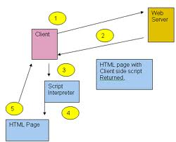
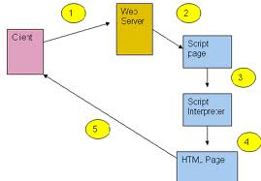
Client-Side & Server Side Comparison

Slide 16
AJAX-ASYNCHRONOUS JAVASCRIPT AND XML
Group of web development techniques used on the client side to create web applications.
web applications can send data to, and retrieve data from, a server in the background without interfering with the display and behavior of the existing page.
Web applications such as Gmail, Maps and Docs are written with AJAX

Slide 17
AJAX Technologies
HTML and CSS: present information as pages.
DOM: change parts of pages while they are viewed.
XML: let programs exchange data with the server.
An asynchronous way to send and retrieve XML data.
JavaScript as a language to bind all this together.

Slide 18
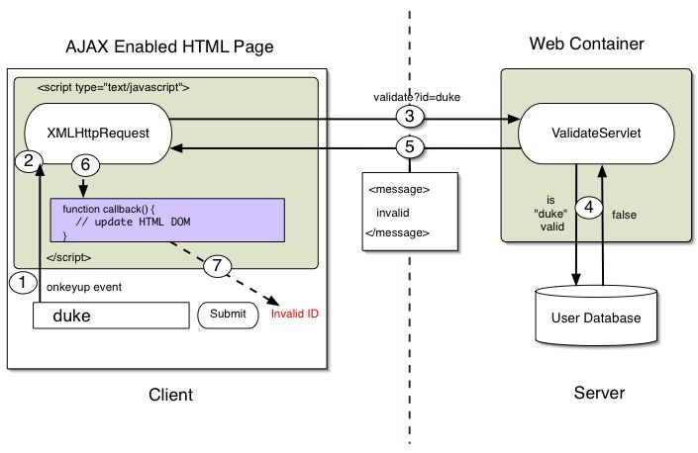
AJAX Client and Server

Slide 19
Hypertext Transfer Protocol
an application protocol for distributed, collaborative, hypermedia information systems.
It’s a simple request-response protocol that runs usually over TCP.
Specifies what messages clients mays send to servers and what responses they get back

Slide 20
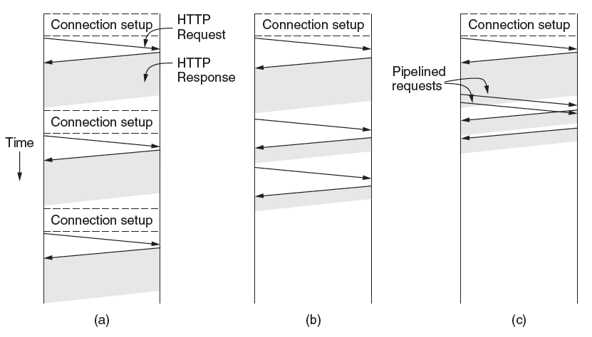
The Hypertext Transfer Protocol
HTTP with multiple connections and sequential requests.
A persistent connection and sequential requests.
A persistent connection and pipelined requests.

Slide 21
Summary
Dynamic web pages are web sites that are generated by a user or changed as a result of interaction with the user.
Client-side server dynamic web pages: Web Pages that change in response to an action such as a mouse or a keyboard
Server-side dynamic web pages: Web pages that change when a web page is loaded or visited
AJAX: Group of web development techniques used on the client side to create web applications.
an application protocol for distributed, collaborative, hypermedia information systems.

Slide 22
What is the Mobile Web?
Mobile Web is a medium that enables access to the World Wide Web using mobile devices to connect to a public network and view Web sites.
  This allows the mobile device to exchange information at any time with the Internet.

Slide 23
Mobile Devices
Mobile device examples:
  Mobile phones (or cellular phones)
  Personal Digital Assistants (PDAs)
  Mobile computers (or laptops/notebooks)
Mobile devices are becoming more popular and powerful around the world
  New devices and updated Firmware are being released
  New wireless capabilities and network coverage are expanding
  New demographics of users, such as the young, old, and poor are able to attain access

Slide 24
Mobile Web Compatablitiy
There are many devices to choose from
The affordability of each device may vary greatly
Web content may be inhibited to fit correctly within the small screen of each device
Computing power of the device, Web browser, and connectively of the network may present issues for older and some new devices

Slide 25
Mobile Web Applications
Applications can be accessed by using a Web browser and are developed using a markup language
This enables improved device compatibility by letting the device decide how to present the content that developers provide
Examples of language: XHTML and Wireless Markup Language (WML)

Slide 26
Web Search
A Web search application is a type of software program that allows users to search for designated terms within web pages on the World Wide Web.
A search application look through databases using certain algorithms on a web crawler to find specified key words of different types of information, such as web pages, video descriptions, image descriptions, and other tpyes of files.

Slide 27
Web Search Engines
Google
Yahoo!
Dogpile
Bing
Ask.com

Slide 28
Web Search History
Archie – The very first tool for manually searching a database of file names from the Internet
Gopher – Searched files for names and titles of plain text documents stored in an indexed system
Wandex – The first indexed search engine to use a web robot that measured the size of the World Wide Web
WebCrawler – The first engine to use a web robot to search not only titles and headings, but all text within a webpage and is the standard of all major search engines

Slide 29
How A Web Search Works
Document and query processing - The search engine retrieves information from the HTML and stores it in an indexed database by using a Web crawler (Web spider), which is an automated Web browser that goes through every link on a Web page and indexes matching queries as a Cache. A Cache is all or part of the information the query matches and the information the Web site, such as the Web Address and data type.
Search and matching functions - When the Caches are indexed, the engine analyses the query to the cache to determine the amount of similarity between the two exists. Boolean operators can also be used to create the list by including term like and, or, and not within the query.
Ranking, summarizing, and presenting documents - The caches form a search result list that ascend from most to least relevant, with the documents title and parts of the text that contains all or part of the matching query, by using algorithms and methods to ranking each search result

Slide 30
Web Search Manipulation
Most web searches rank results higher than other results that match more with the quiry for:
Political purposes
Business purposes (i.e. paid advertising)
Comedic purposes
http://www.youtube.com/watch?v=90cfeFBid68

