Slide 1
VPN and Types of Securtiy
Group 9: Varun Upadhyay

Slide 2
8.6: Virtual Private Networks
VPN are overlay networks on top of public networks but with most of the properties of private networks. They are called ‘‘virtual’’ because they are merely an illusion
A common design is to equip each office with a firewall and create tunnels through the Internet between all pairs of offices
tunnels can be set up on demand to include, for example, the computer of an employee who is at home or traveling as long as the person has an Internet connection.
When the system is brought up, each pair of firewalls has to negotiate the parameters of its SA
If IPsec is used for the tunneling, it is possible to aggregate all traffic between any two pairs of offices onto a single authenticated, encrypted SA

Slide 3
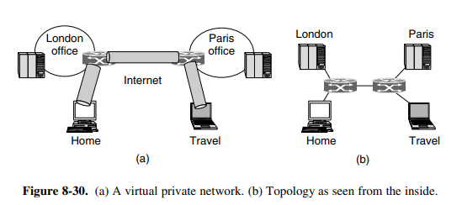
8.6: VPN Advantages
A key advantage of a VPN is that it is completely transparent to all user software. The firewalls set up and manage the SAs. The only person who is even aware of this setup is the system administrator who has to configure and manage the security gateways, or the ISP administrator who has to configure the MPLS paths. To everyone else, it is like having a leased-line private network again.

Slide 4
8.6: WEP
The first gen of WPA2 is WEP which was a disaster because:
WEP encrypted data for confidentiality by XORing it with the output of a stream cipher. Unfortunately, weak keying arrangements meant that the output was often reused. This led to trivial ways to defeat it
Integrity check was based on a 32-bit CRC. Which is efficient for detecting transmission errors, but not cryptographically strong mechanism for defeating attackers.

Slide 5
8.6: 802.11 (WPA2)
802.11 (WPA2) is data link level security protocol for preventing a wireless node from reading or interfering with messages sent between other wireless nodes.
Corporate setting when a company has separate authentication and Clients use standard protocols to authenticate themselves to the network. The main standards are:
802.1X, with which the access point lets the client carry on a dialogue with the authentication server and observes the result
EAP (Extensible Authentication Protocol), which tells how the client and the authentication server interact
Small businesses and homes where no authentication is required (less secure). The main difference is that with an authentication server each client gets a key for encrypting traffic that is not known by the other clients. With a single shared password, different keys are derived for each client, but all clients have the same password and can derive each others’ keys if they want to.

Slide 6
8.6: Bluetooth Security
Shorter Range than Wireless security
Bluetooth provides security in multiple layers. In the physical layer, frequency hopping provides a tiny little bit of security, but since any Bluetooth device that moves into a piconet has to be told the frequency hopping sequence, this sequence is obviously not a secret. The real security starts when the newly arrived slave asks for a channel with the master. Before Bluetooth 2.1, two devices were assumed to share a secret key set up in advance. In some cases, both are hardwired by the manufacturer
Another security issue is that Bluetooth authenticates only devices, not users, so theft of a Bluetooth device may give the thief access to the user’s financial and other accounts.

