Slide 1
Security Overview
1.1
Introduction
TestOut Security Pro

Slide 2
Key Terms
Security Confidentiality Integrity Availability Non-Repudiation Asset
TestOut Security Pro

Slide 3
Key Terms
Threat Threat agent Vulnerability Exploit
TestOut Security Pro

Slide 4
Key Definitions
Security: The degree of protection against danger, damage, loss, and criminal activity. Confidentiality: Confidentiality ensures that data is not disclosed to unintended persons. Integrity: Integrity ensures that data is not modified or tampered with. Availability: Availability ensures that a system is up so that data is available when needed. Non-Repudiation: Non-repudiation provides the validation of a message's origin.
TestOut Security Pro

Slide 5
Key Definitions
Asset: Something that has value to an individual or an organization. Threat: Anything that has the potential to cause the loss of an asset. Threat agent: The person or entity that attempt or carries out a threat. Vulnerability: An opening or weakness in the system. Exploit: An act, procedure, or piece of software that takes advantage of a vulnerability to carry out an attack.
TestOut Security Pro

Slide 6
Security Concepts

Slide 7
Security Concepts
Assets Threats Threat agents
TestOut Security Pro

Slide 8

Security Concepts
TestOut Security Pro

Slide 9

Security Concepts
TestOut Security Pro

Slide 10
Security Concepts
Assets Threats Threat agents Vulnerability
TestOut Security Pro

Slide 11

Security Concepts
TestOut Security Pro

Slide 12
Security Concepts
Assets Threats Threat agents Vulnerability Exploit
TestOut Security Pro

Slide 13
Class Discussion
What challenges does a security professional face? What is the difference between integrity and non-repudiation? What are the three main goals of the CIA of Security? What are the key components of risk management? What are three types of threat agents?
TestOut Security Pro

Slide 14
Defense Planning
1.2
Introduction
TestOut Security Pro

Slide 15
Key Terms
Layered security Layered security model
TestOut Security Pro

Slide 16
Key Definitions
Layered security: A security approach that combines multiple security controls and defenses to create a cumulative effect. Layered security model: A security approach that defines seven layers of security.
TestOut Security Pro

Slide 17
The Layered Security Model

Slide 18

The Layered Security Model
TestOut Security Pro

Slide 19

The Layered Security Model
TestOut Security Pro

Slide 20

The Layered Security Model
TestOut Security Pro

Slide 21

The Layered Security Model
TestOut Security Pro

Slide 22

The Layered Security Model
TestOut Security Pro

Slide 23

The Layered Security Model
TestOut Security Pro

Slide 24

The Layered Security Model
TestOut Security Pro

Slide 25

The Layered Security Model
TestOut Security Pro

Slide 26

The Layered Security Model
TestOut Security Pro

Slide 27
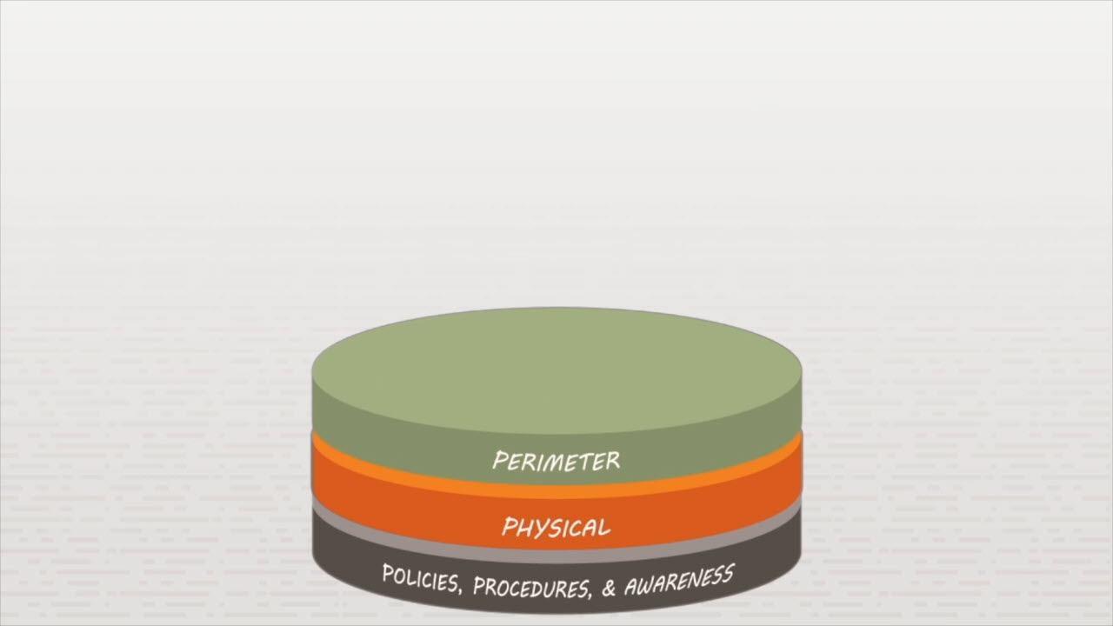
The Layered Security Model
TestOut Security Pro

Slide 28
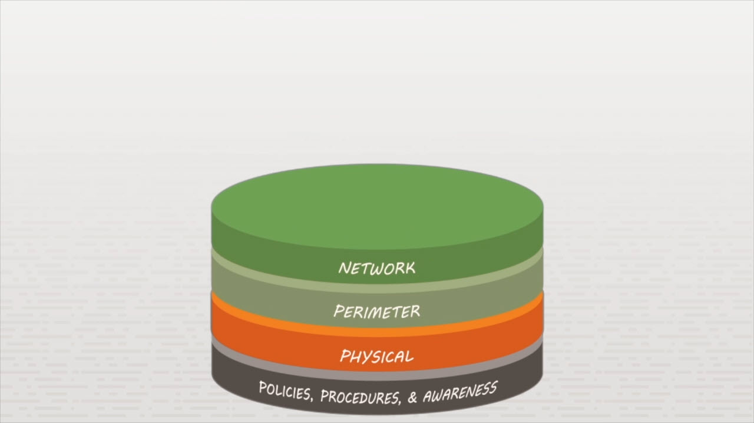
The Layered Security Model
TestOut Security Pro

Slide 29
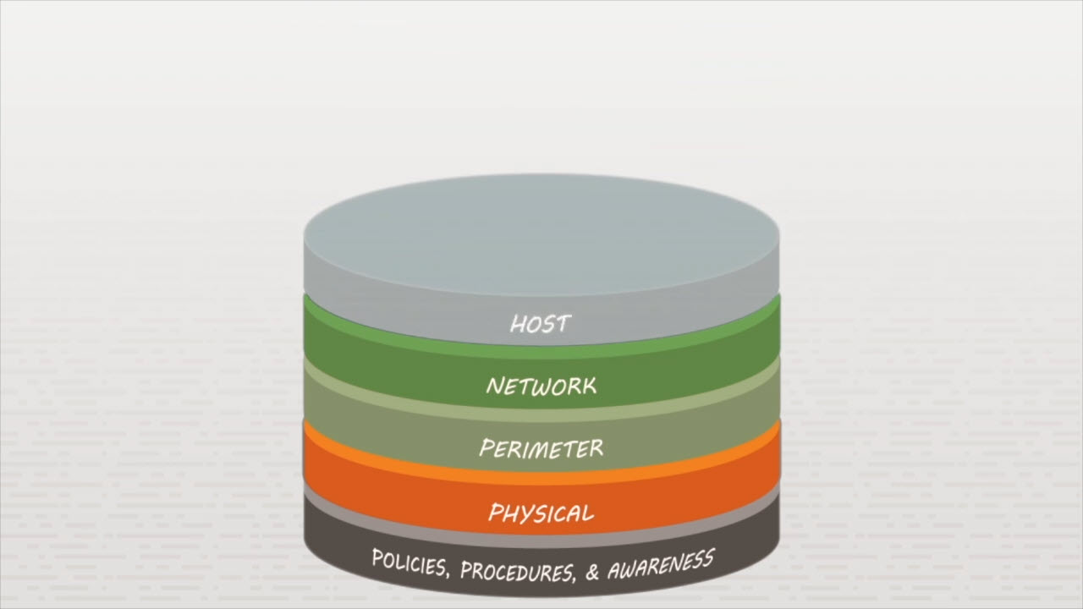
The Layered Security Model
TestOut Security Pro

Slide 30
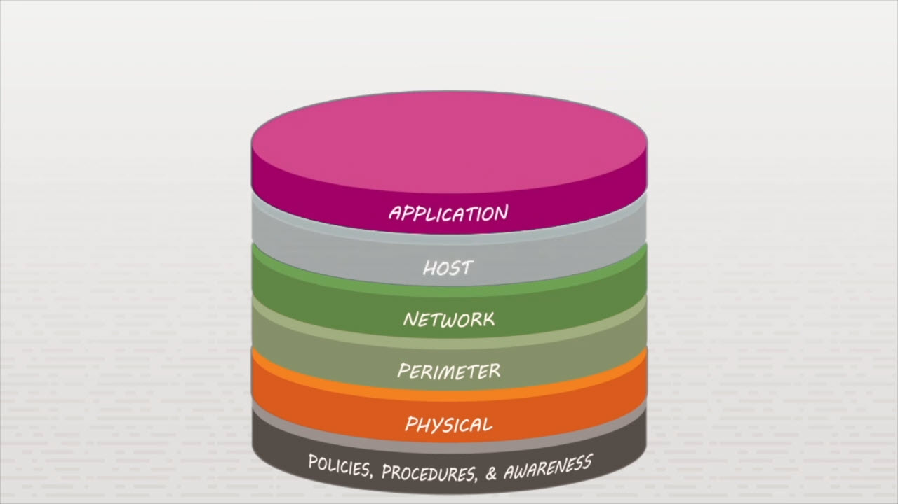
The Layered Security Model
TestOut Security Pro

Slide 31
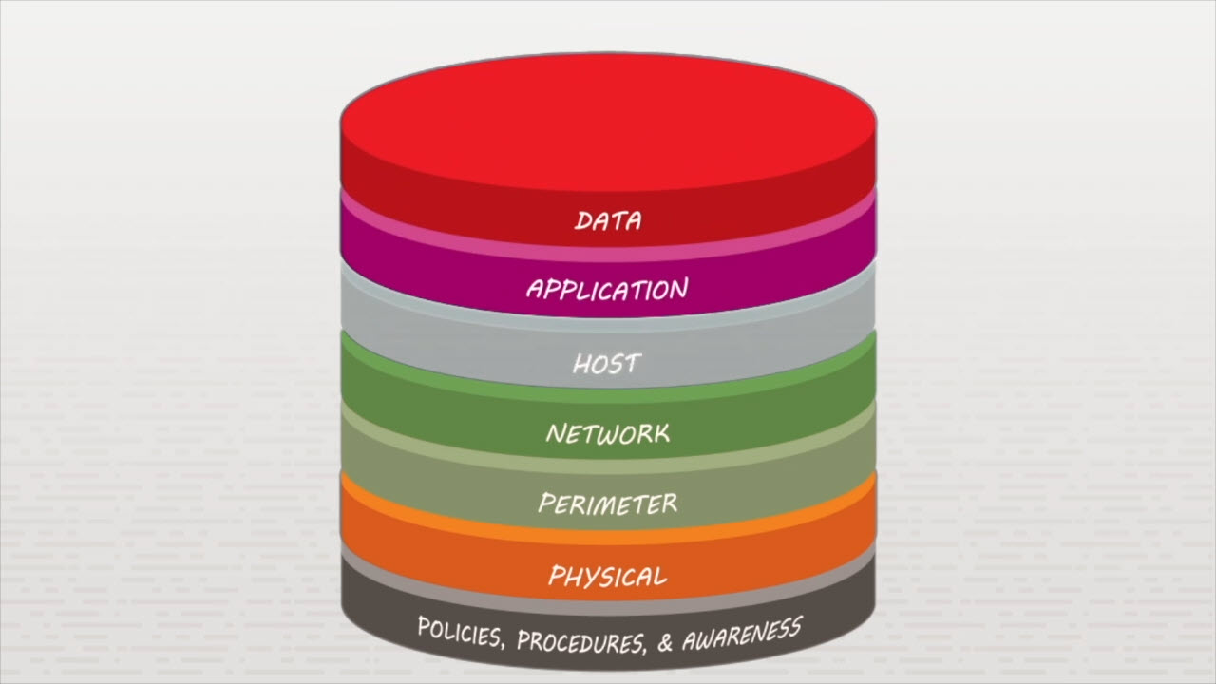
The Layered Security Model
TestOut Security Pro

Slide 32

The Layered Security Model
TestOut Security Pro

Slide 33

The Layered Security Model
TestOut Security Pro

Slide 34
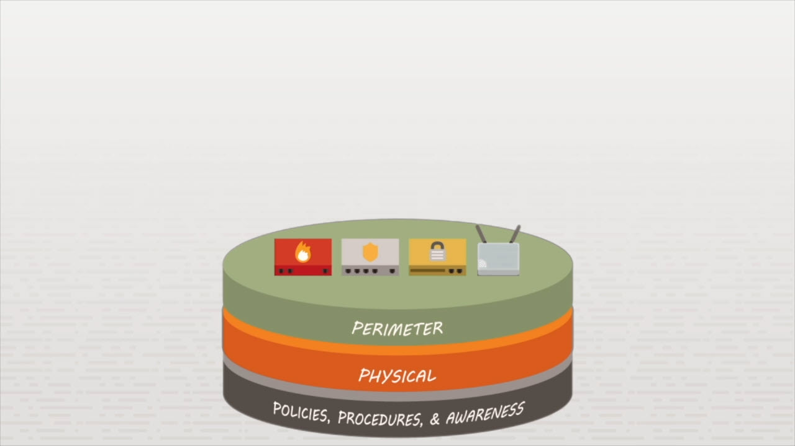
The Layered Security Model
TestOut Security Pro

Slide 35
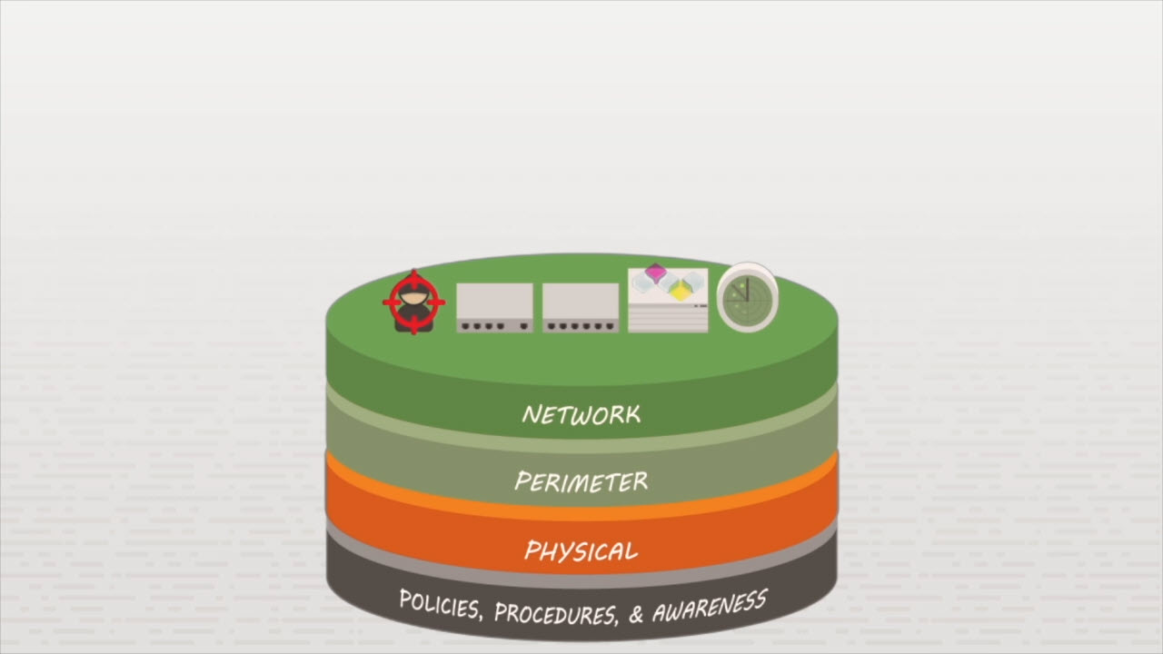
The Layered Security Model
TestOut Security Pro

Slide 36
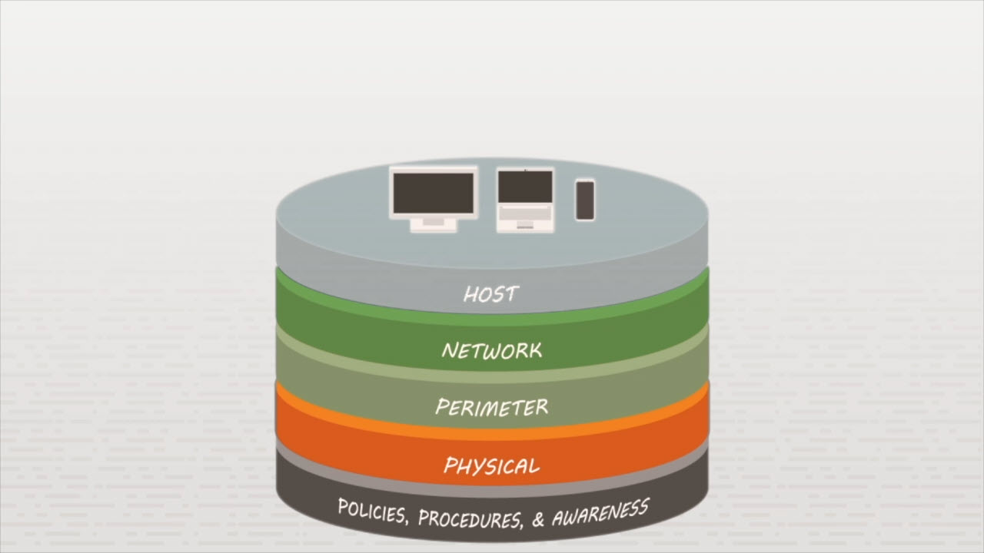
The Layered Security Model
TestOut Security Pro

Slide 37
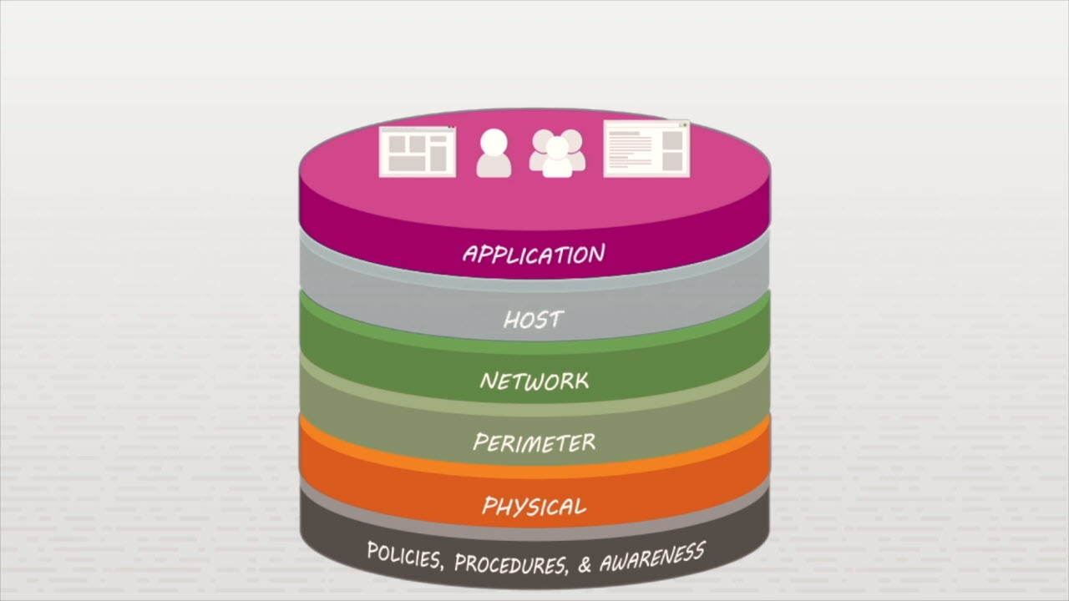
The Layered Security Model
TestOut Security Pro

Slide 38
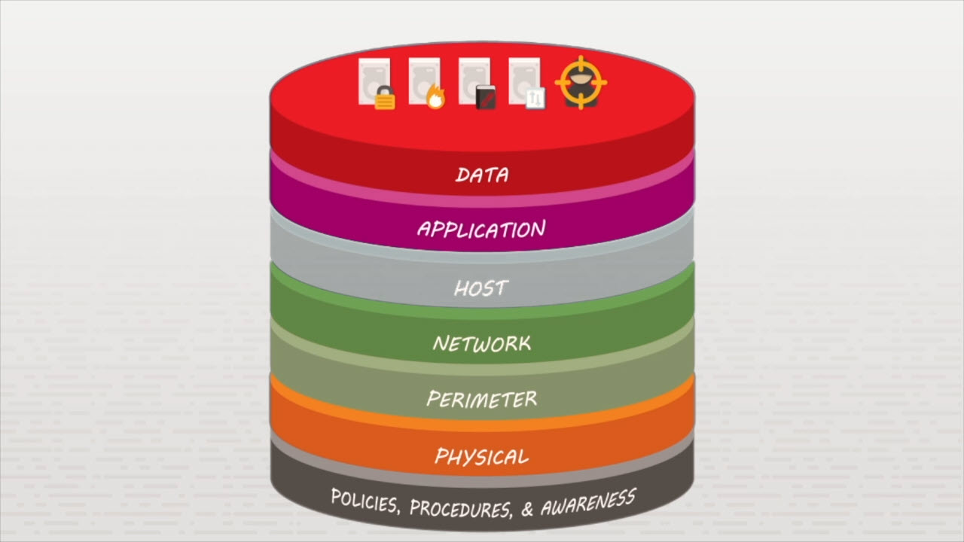
The Layered Security Model
TestOut Security Pro

Slide 39
User Education

Slide 40
Essential Security Training
Employees are primary targets Understanding attack strategies Identifying internal threats Company security policies
TestOut Security Pro

Slide 41
Class Discussion
What is layered security? What are the seven layers in layered security? What is a countermeasure? How can countermeasures reduce the risk of a threat agent being able to exploit a vulnerability?
TestOut Security Pro

